Slide 1



“ Clinic OPD Management System”
Submitted by: Anisha Kewat
Submission type : Individual
Name: Anisha Kewat
Batch : 12
LMS Id : kewatanisha893@gmail.com
Program : Full Stack Development
Date: 25/05/2023
Git : https://github.com/Anishakewat/ClinicManagement.git

Slide 2


Table of contents
Introduction
Project Overview
Architecture Design
Back-end Development
Front-end Development
Deployment
Conclusion
Future Work
References

Slide 3
Introduction
This Clinic OPD management System is a web based app which is developed in multilayered architecture.
So we have implemented data access layer through hibernet using JPA specification and has its own crud repository
presentation layer using MVC, also Lombok which reduces boiler plate code.
spring dev tools which is developer tool , the aim is to try and improve the development time and changes and restart the application .
Thymeleaf for the frontend which supports html5 and i have also added bootstrap in it.
So it is full stack app, where database is through SQL yog, frontend is through thymeleaf, backend in spring boot.

Slide 4
Project Overview
Functionalities:
Doctor/ Patient Registration : Enable users to independently register and gain access to your system.
2. Doctor/ Patient Login :Utilizes the credentials of the user, in order to authenticate their access.
3. Doctor/ Patient Logout : Loging out means to end access to a computer system or a website.
4. Crud operations : CREATE, READ, UPDATE and DELETE. These terms describe the four essential operations for creating and managing persistent data elements.
5. Validations :The Spring MVC Validation is used to restrict the input provided by the user.It can validate both server-side as well as client-side applications.

Slide 5
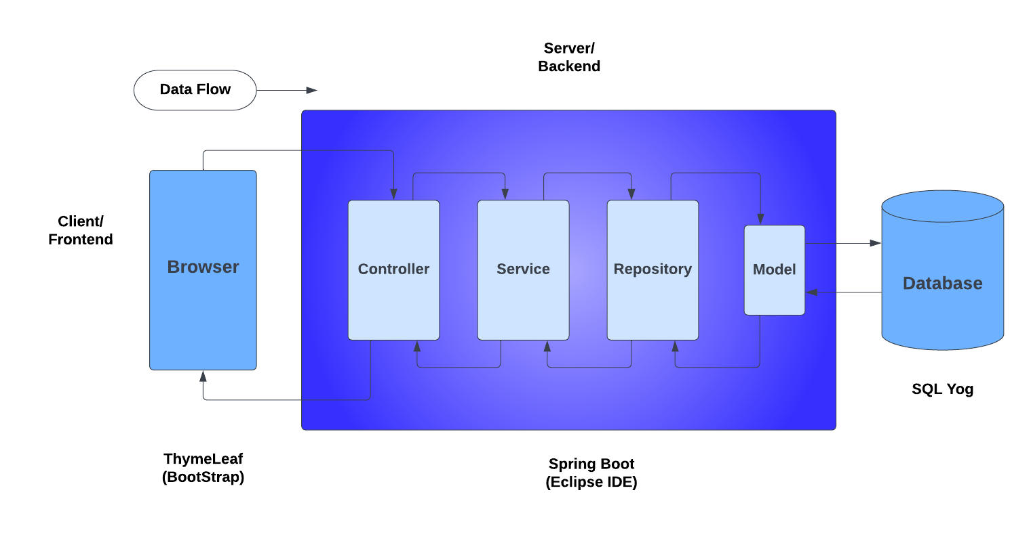
Architecture Design

Slide 6
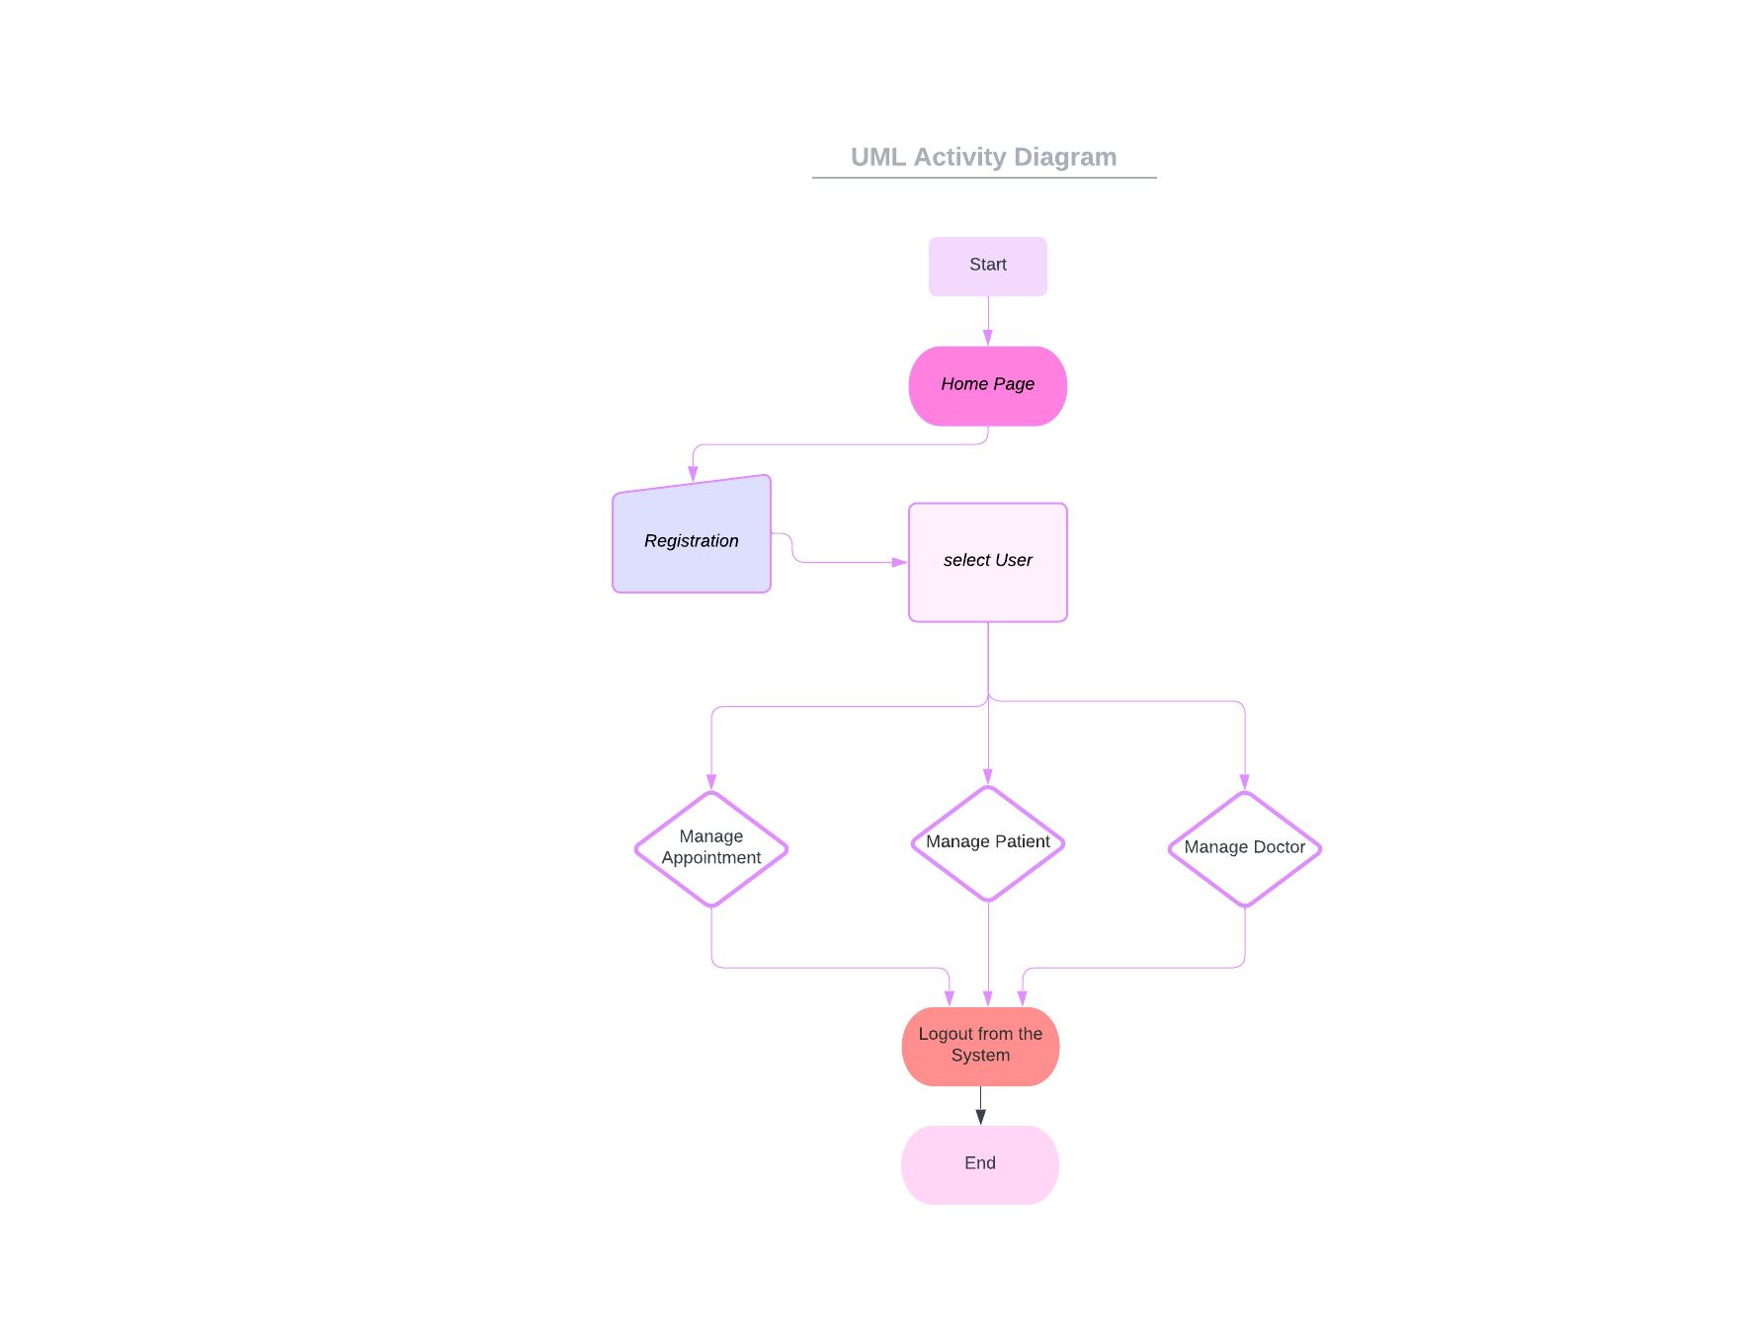
UML Activity Diagram
Initial Node: The diagram starts with an initial node indicating the beginning of the activity flow.
Registration: The first activity is the registration process. It involves capturing such as username, contact information and more.
User Selection: Once the user is registered, the next activity is to select a doctor. This activity involves presenting the user with a list of selected user.
Logout :Logging out with the current user id.

Slide 7


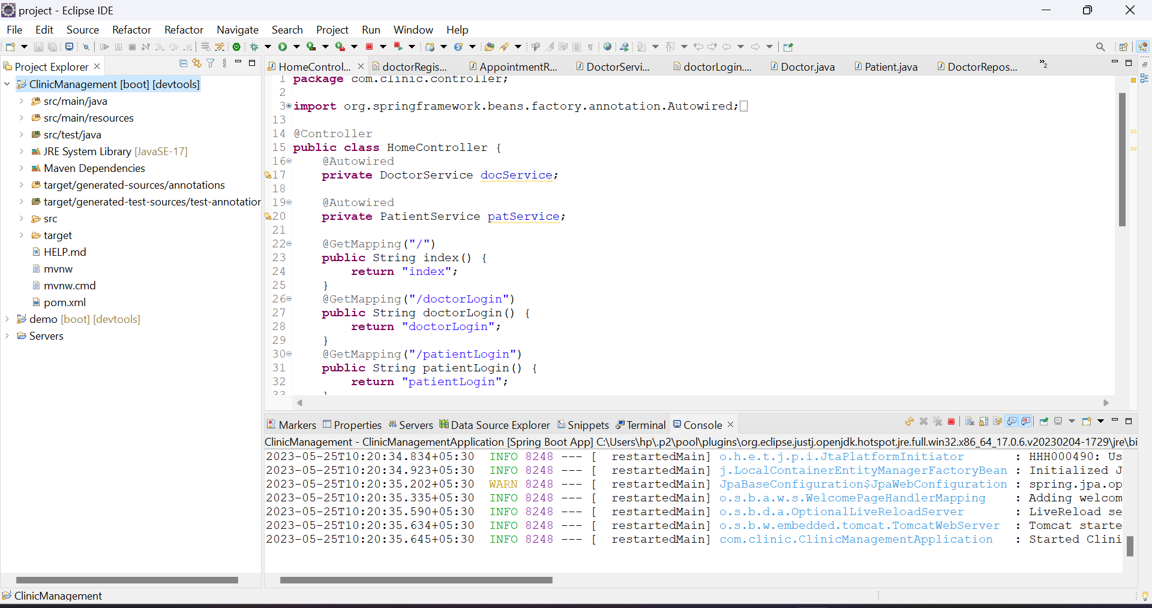



Back-end Development
HIBERNATE
TOMCAT SERVER

Slide 8
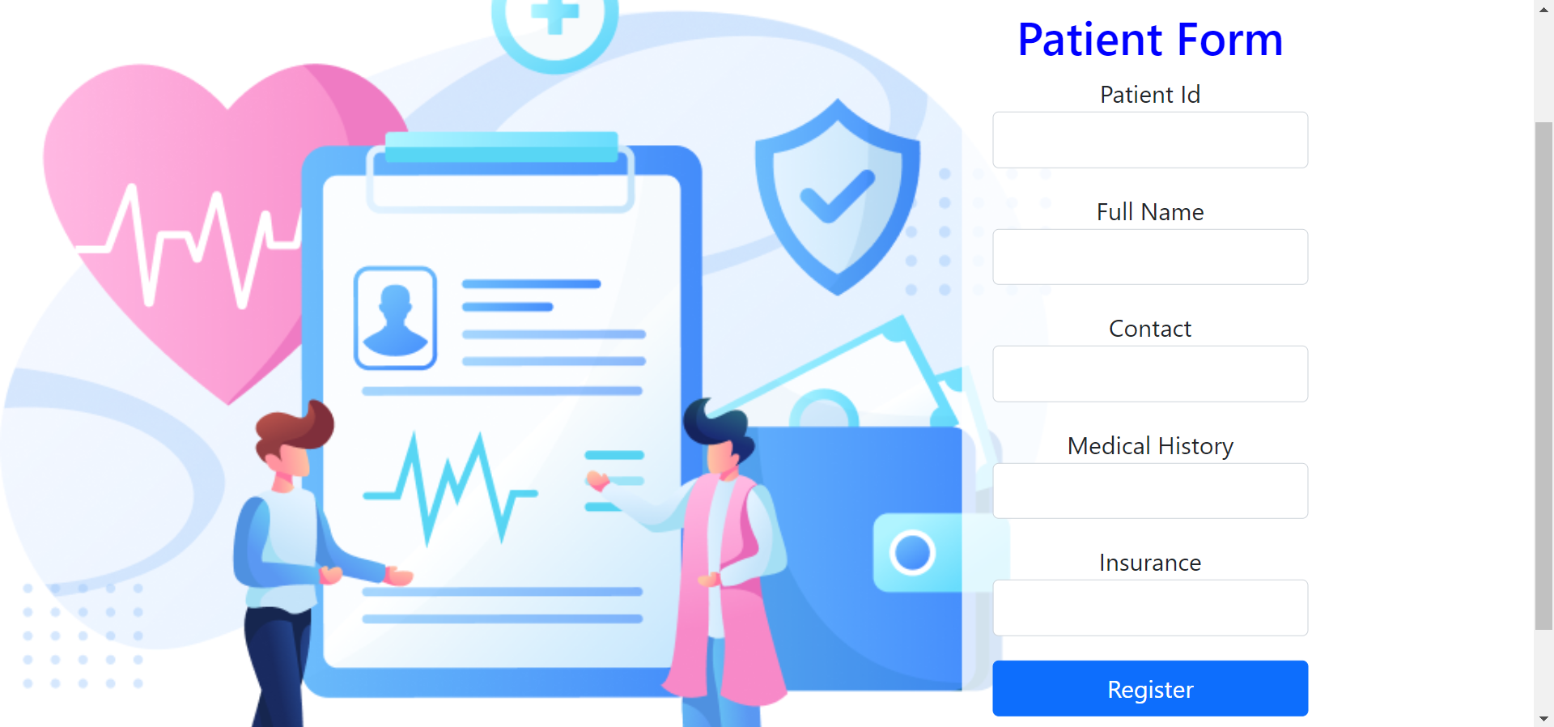
Front-end Development

Slide 9
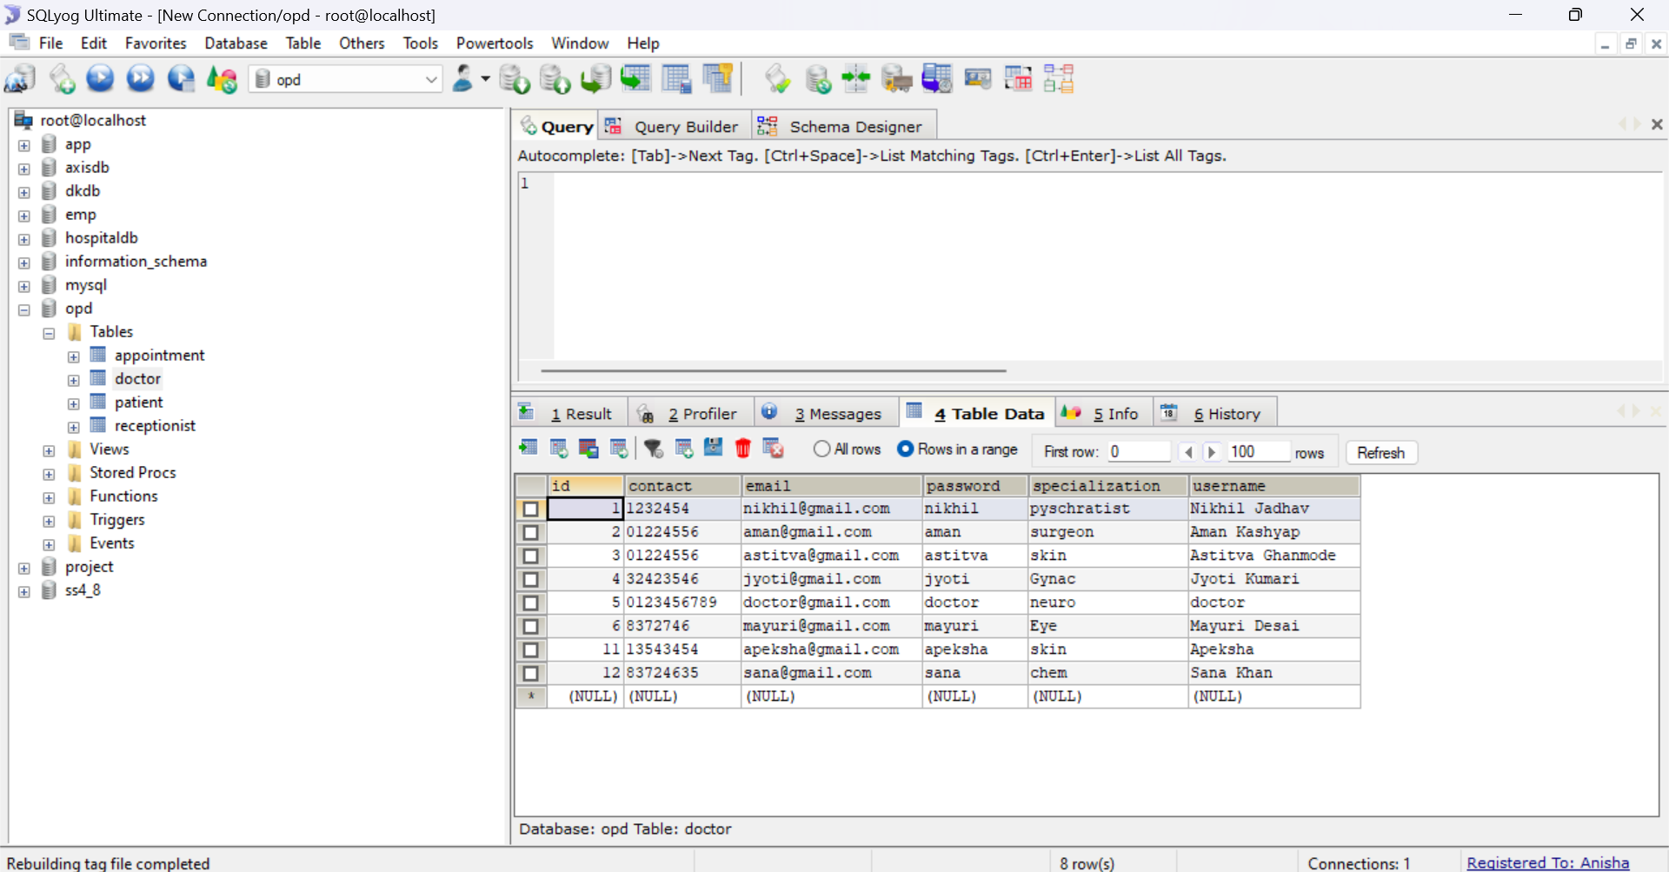
Deployment

Slide 10

Conclusion
• Since we are entering the details of the patients electronically in the "Clinic OPD Management System”, data will be secured.
• It easily reduces the book keeping task and thus reduces the human effort and increases accuracy, speed.

Slide 11

Future Work
To use spring security: to offer a highly customizable way of implementing authentication, authorization, access-control and protection against common attack.
Electronic Medical Records (EMR): Develop a comprehensive EMR system that allows healthcare providers to securely store and access patient records , along with prescribtion and cancellation of appointment.
Billing Integration: Integrate with billing systems providers to automate the billing process, generate invoices.
Prescription Management: Enhance the prescription management module to support electronic prescriptions, automatic drug interaction checks, dosage recommendations.

Slide 12

References
https://spring.io/projects/spring-boot
https://www.thymeleaf.org/documentation.html
https://jakarta.ee/specifications/persistence/
https://dev.mysql.com/doc/
https://docs.spring.io/spring-security/site/docs/current/reference/html5/

Slide 13

End
Thank You!!

